Slide 1

Team Project Title
Member Names (First Last)
Team Number
Team Name Major
CS506 Spring 2025

Slide 2
Agenda
What is Pandas and Why Use It
Understanding Series and DataFrame
Basic Operations & Data Manipulation
File Input and Output (IO Tools)
Data Selection and Filtering
Visualization with Pandas & Seaborn
Relationship with NumPy
Real-World Use Cases

Slide 3
What is Pandas
Open-source data analysis and manipulation tool
Built on top of NumPy
Ideal for structured data operations

Slide 4
Key Features of Pandas
Labeled axes (rows and columns)
Powerful group by functionality
Easy data loading/saving
Integrated with visualization libraries

Slide 5
Data Structures
Series: One-dimensional array with labels
DataFrame: Two-dimensional, table-like structure
Comparison and conversion between Series & DataFrame

Slide 6
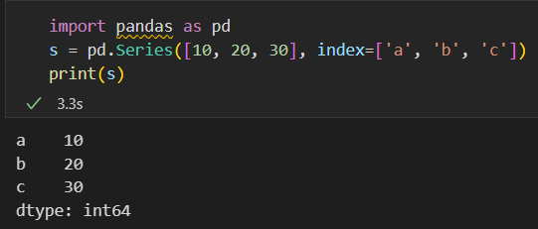
Creating a Series
Indexing and slicing

Slide 7
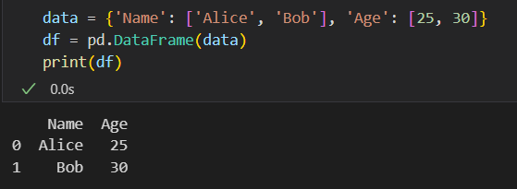
Creating a DataFrame
Show output format

Slide 8
Basic Data Operations
df.head(), df.tail(), df.info(), df.describe()
df['col'], df[['col1', 'col2']], df.dtypes
Data type conversions and NA handling

Slide 9
Modifying Data
Renaming: df.rename()
Dropping columns: df.drop()
Filling NAL df.fillna()
Type conversion: df.astype()

Slide 10
Arithmetic and Aggregation
Column-wise operations: df[‘A’] + df[‘B’]
Aggregations: df.sum(), df.mean()
Groupby example

Slide 11
IO Tools - Reading and Writing
Read: read_csv(), read_excel(), read_json()
Write: to_csv(), to_excel(), to_json()

Slide 12
Selecting Data - Basics
df[‘col’], df[[‘col1’, ‘col2’]]
df.iloc[0], df.loc[0]
Boolean indexing

Slide 13
Selecting Data - Advanced
Slicing: df[1:3], df.loc[1:3]
Conditional filtering: df[df[‘Age’] > 25]
Multi-indexing basics

Slide 14
Data Cleaning
Handle Nans: isnull(), dropna()
Remove duplicates: drop_duplicates()
Replace values: replace()

Slide 15
Visualization Basics
Line plot: df.plot()
Histogram: df.hist()
Box plot: df.boxplot()

Slide 16
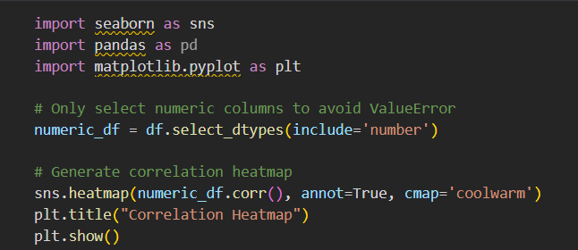
Visualization with Seaborn

Slide 17
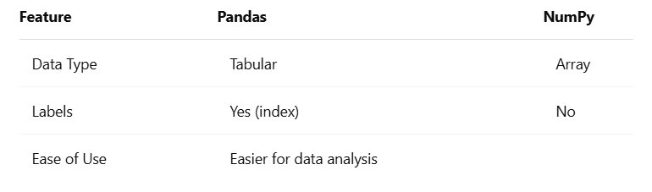
Pandas vs NumPy

Slide 18
Use Cases for Pandas
Financial data analysis
Cleaning data for ML models
Data wrangling in web scraping
Exploratory Data Analysis (EDA)

Slide 19
Summary
Pandas is essential for data handling in Python.
Easy to load, transform, analyze, and visualize data.
Strong ecosystem with NumPy, Matplotlib, Seaborn.

Slide 20


Q&A

